Slide 1

Transit Electrification Simulation Software for STM Bus route 211
INSE 6260 (Software Quality Assurance)
Submitted to: Dr. Chun Wang
Submitted by: Yu JIN (3753034)
Daniel Zakerifar (40054453)

Slide 2
Policies
When to charge the bus?
if, (waiting time < 20 minutes & battery remaining > 90) then, No charging required
If, (waiting time >20 minutes & battery remaining >90) then, charge using high speed charger
If, (battery remaining <90) then, charge using low speed charger
Charging Time Required by slow speed charger
At least 30 minute
Charging Time Required by high speed charger
At most 1 minutes

Slide 3
Policies….(continue)
4. What is the charging rate of chargers?
ABB = 1 minute of charging will charge the battery to 7units
HELIOX = 1 minute of charging will charge the battery to 5 units
What is the utilization of bus battery?
1km of distance will utilizes 1kwh of energy

Slide 4
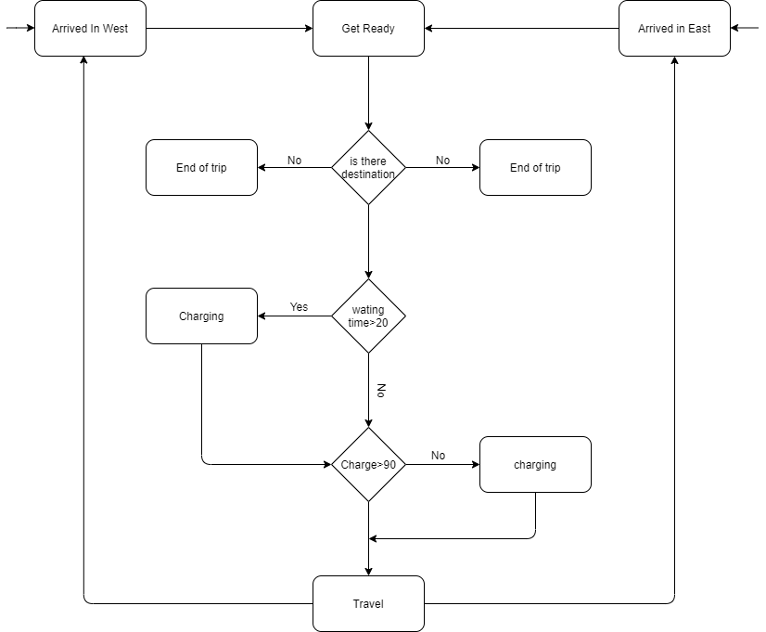
Algorithm

Slide 5
Are we building the right software?
Requirements:
The charge of battery should always be greater than zero
When charge of battery is less than 20% the bus can not travel until it goes charging.
Whenever charging >20 % it can travels
The bus can not be in the two positions at the same time
The state of battery can not be>100%)

Slide 6
We validate the software with the NUSMV
Charge + X
Location: West
Status: Arrived
Charge + X
Location: West
Status: charging
Charge - X
Charge - X
Charge - X
Location: East
Status: Charging
Charge + X
Location: East
Status: Arrived
This is the model of algorithm

Slide 7
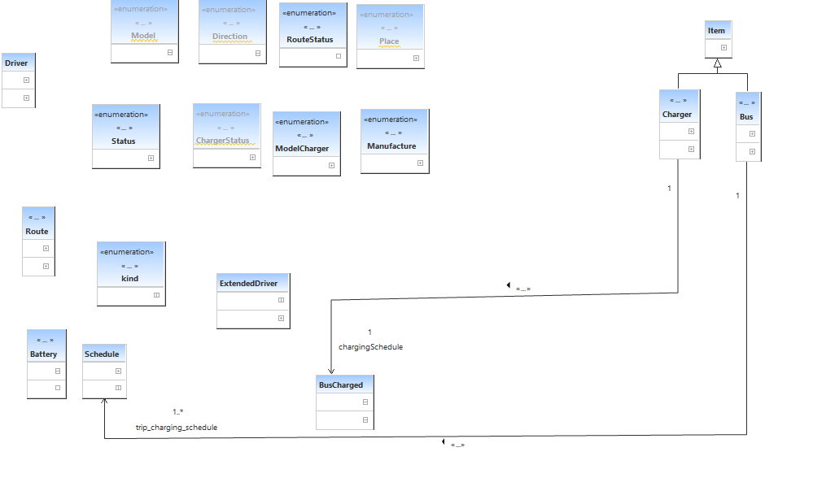
Design
Developed 3 sub systems, 18 classes, +50 Attributes, +30 Methods, ~1500 LOC , few test cases

Slide 8
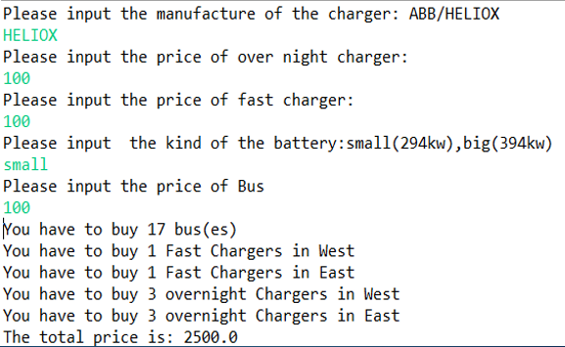
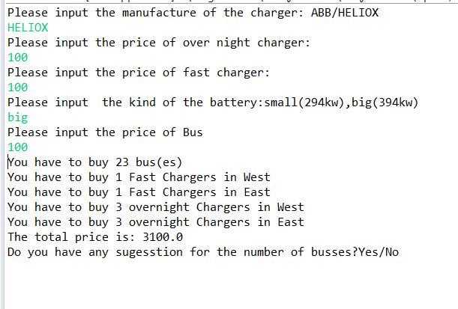
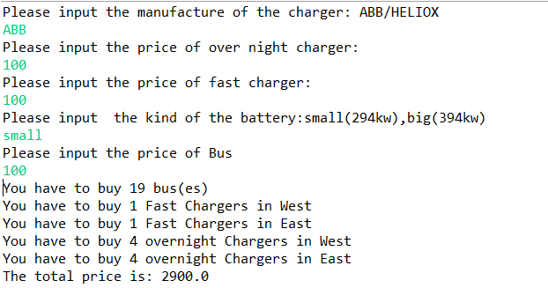
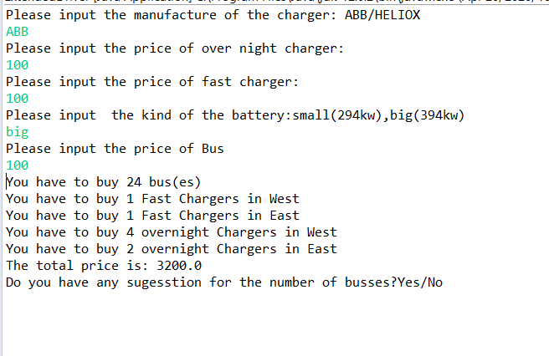
Result
HELIOX with small battery

Slide 9
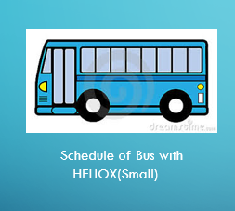
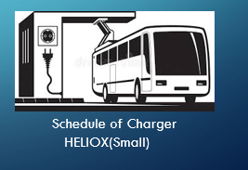
Result…Continue

Slide 10
THANK YOU!

